Slide 1
Algorithm & Programming Program Bilangan Prima
Kelompok 2:
Alice Shizuka Hutagaol – 825210195
Christopher Andrew – 825210107
Ellen Gabriel Limbor - 825210125
Neil Nathan Sutanto – 825210116
Gaizka Mendita - 825210096
Sekar Aurannisa - 825210087

Slide 2
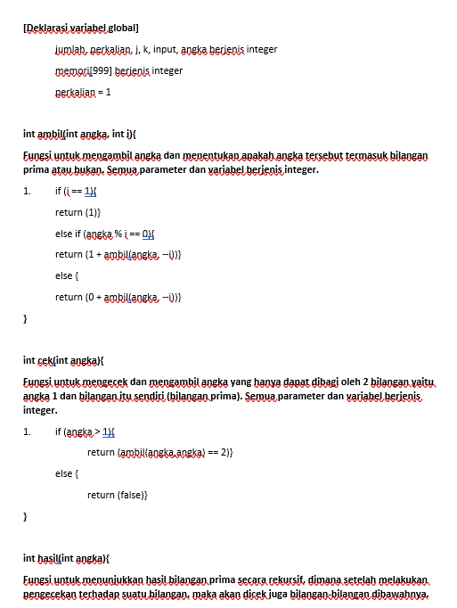
Pseudocode

Slide 3
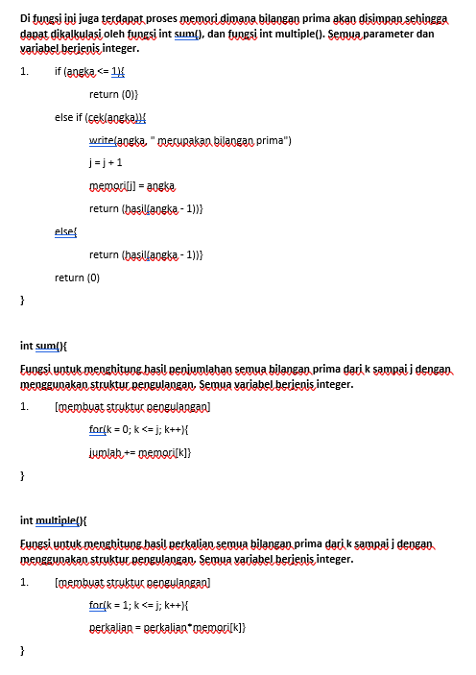

Slide 4
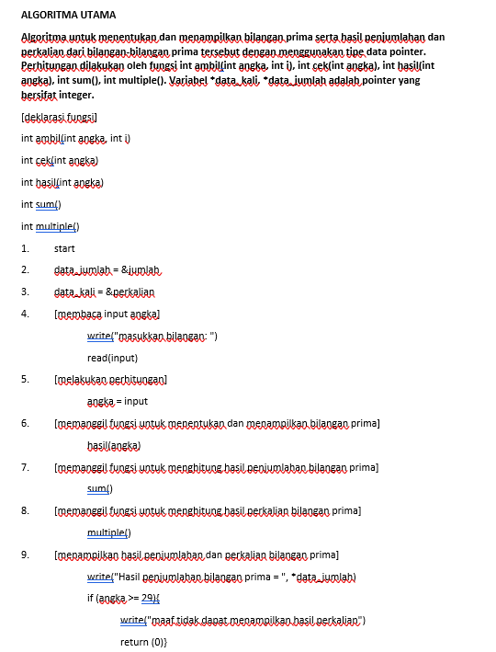
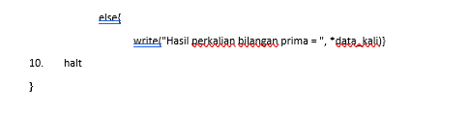

Slide 5
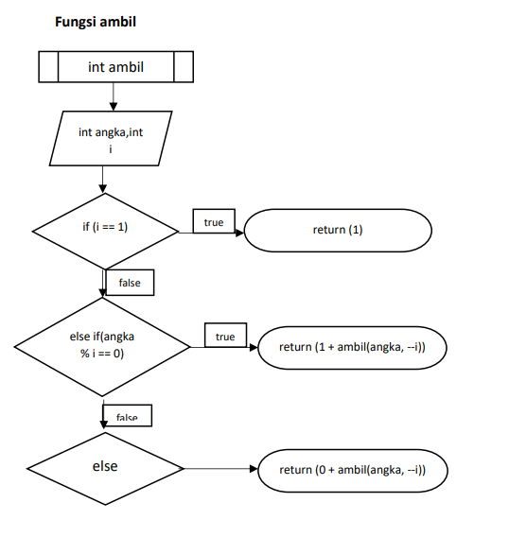
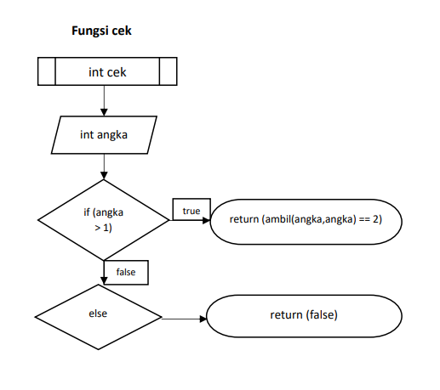
Flowchart

Slide 6
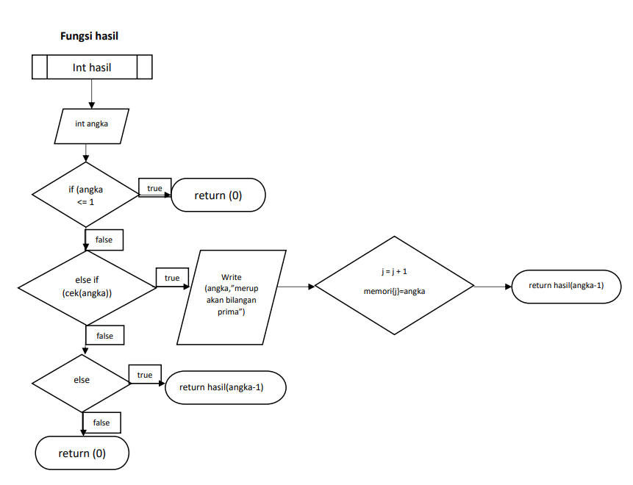

Slide 7
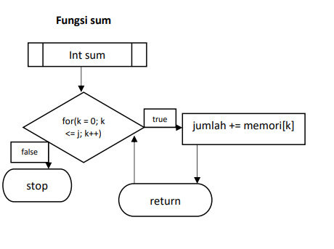
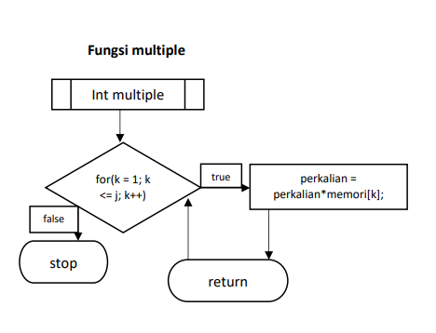

Slide 8
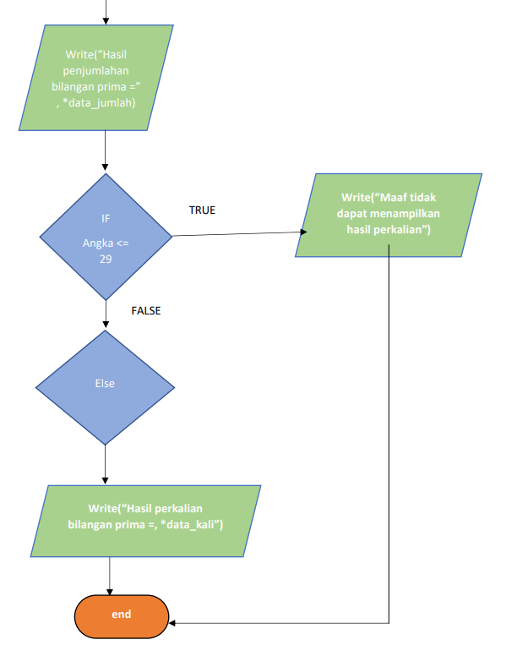
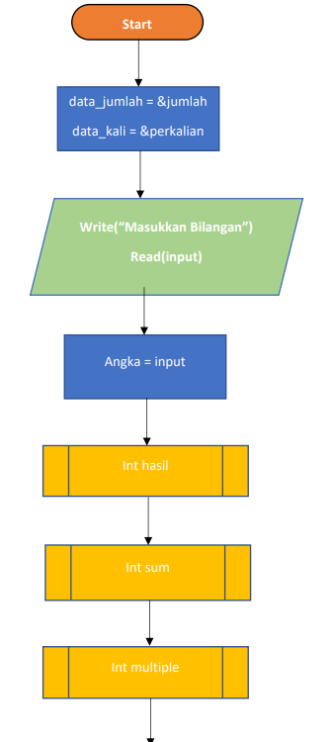

Slide 9
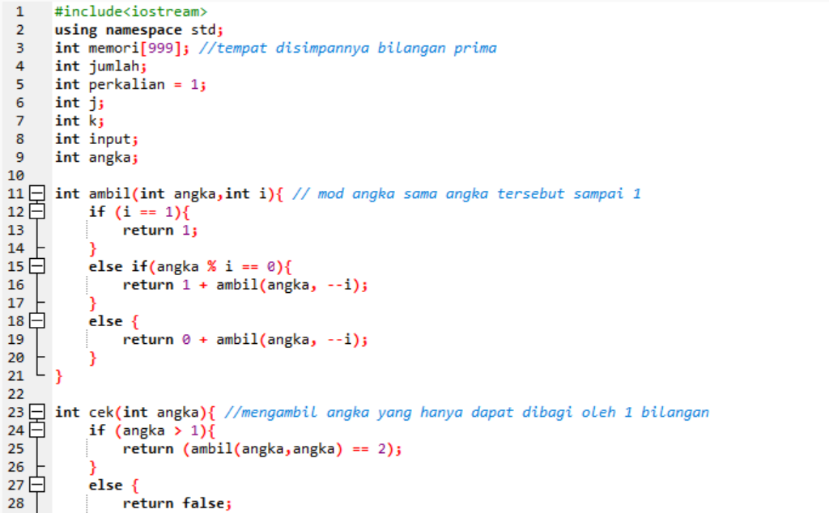
C++ & Sourcecode

Slide 10
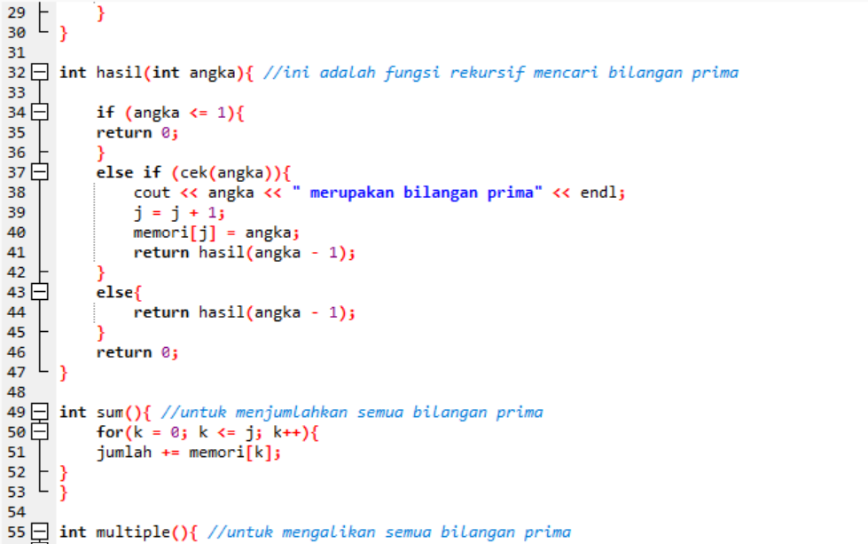
Change your background in Google Meet
To help limit distractions or make video calls more fun, you can now blur your background or replace your background with an image

Slide 11
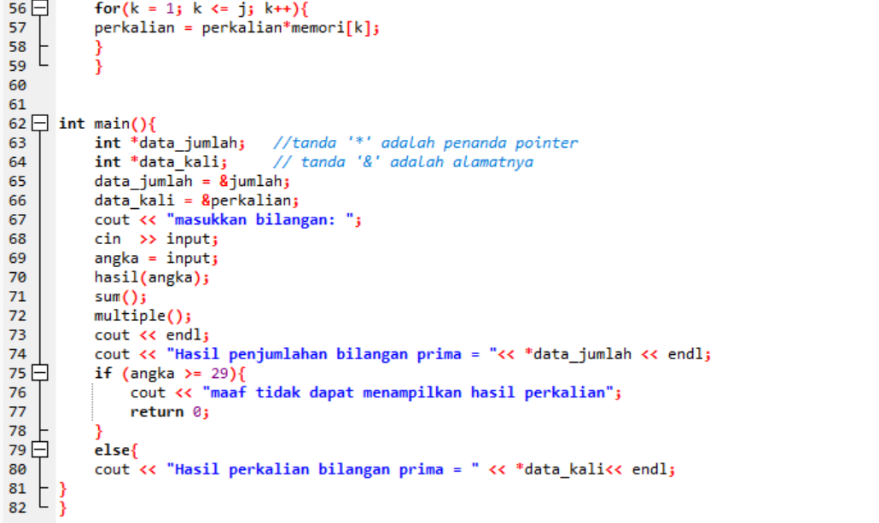

Slide 12


